Slide 1
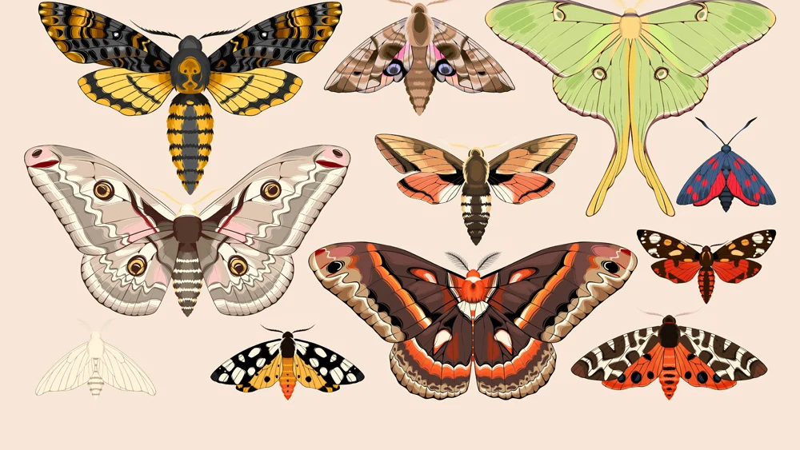
Butterflies and moths

Slide 2
Did you know?
1. There are more than 2500 species of moth in the UK alone. ...
2. Moths are indicator species, which means their numbers tell our scientists if an ecosystem is doing well or badly. ...
3. Hardly any moths will eat your clothes!! ...
4. Moths don't just fly at night.
5. Five butterflies have become extinct in Britain in the last 150 years
6. Many butterflies can taste with their feet
7. A butterfly’s lifecycle is made up of four parts, egg, larva (caterpillars), pupa (chrysalis) and adult.
8. 57 resident species of butterflies and two regular migrants – the Painted Lady and Clouded Yellow.

Slide 3
Example:
Light catcher butterfly or moth
You will need:
Scissors
Pen
Cardboard
Pens/paint
And items to fill the wings with e.g. tissues paper/ bubble wrap

Slide 4
First you need to draw out the shape of your butter fly on cardboard. – no bigger than 40cm squared no smaller than 20cm square.
Tip- you might find it easier to fold the cardboard in half and just draw one half of the butterfly
You then need to cut out your butterfly shape, including windows in the wings for you to add the “light catcher” element.

Slide 5
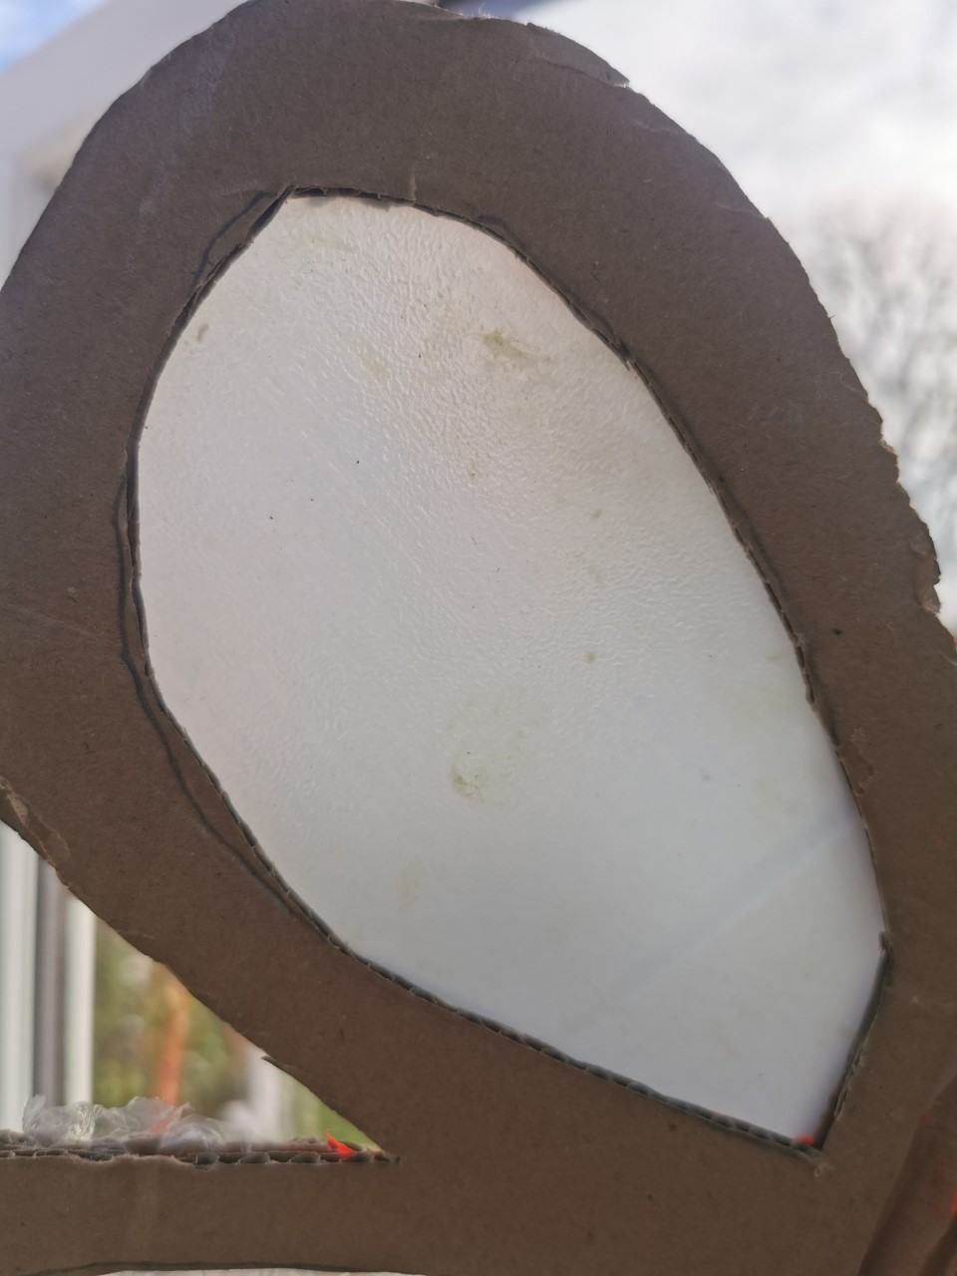
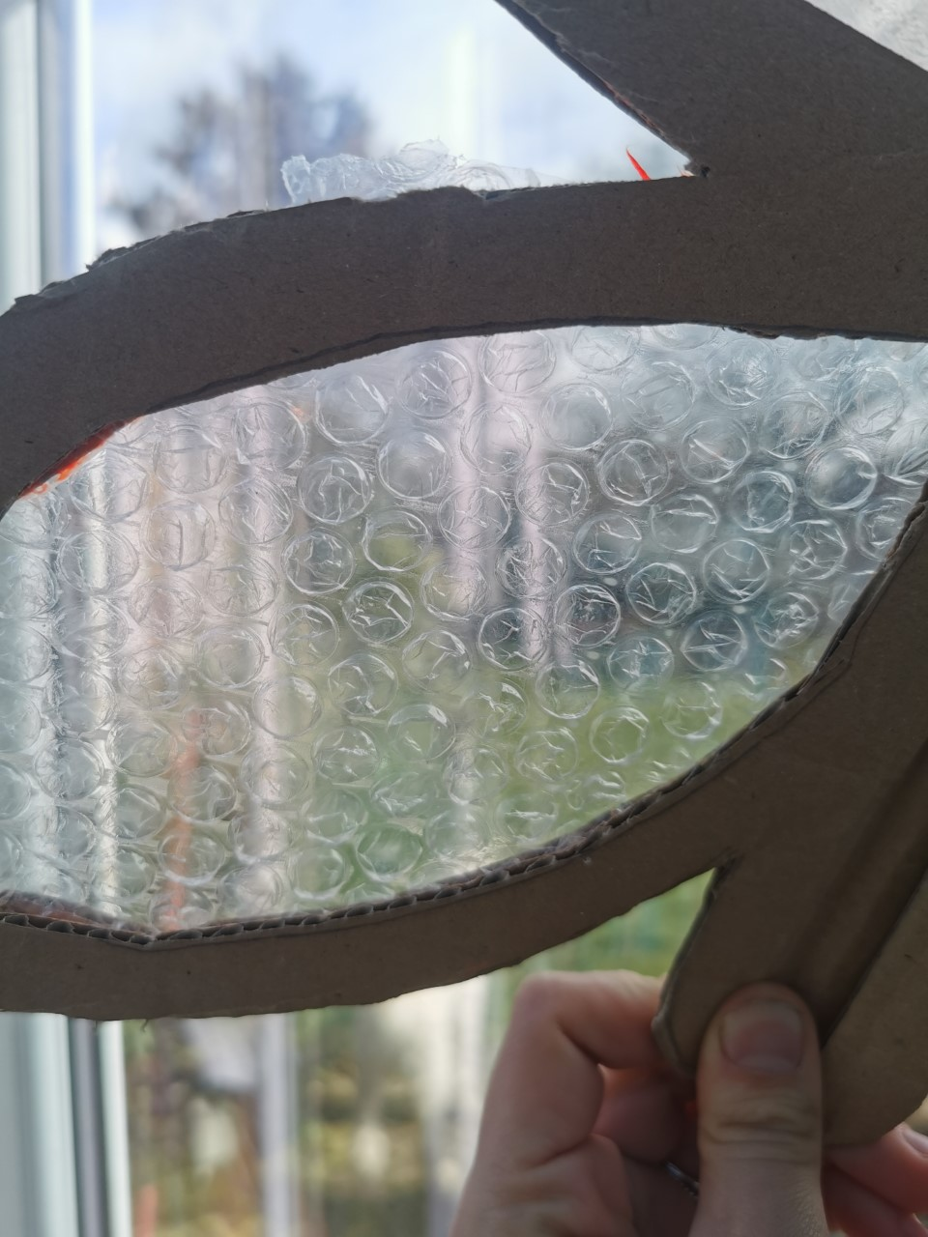
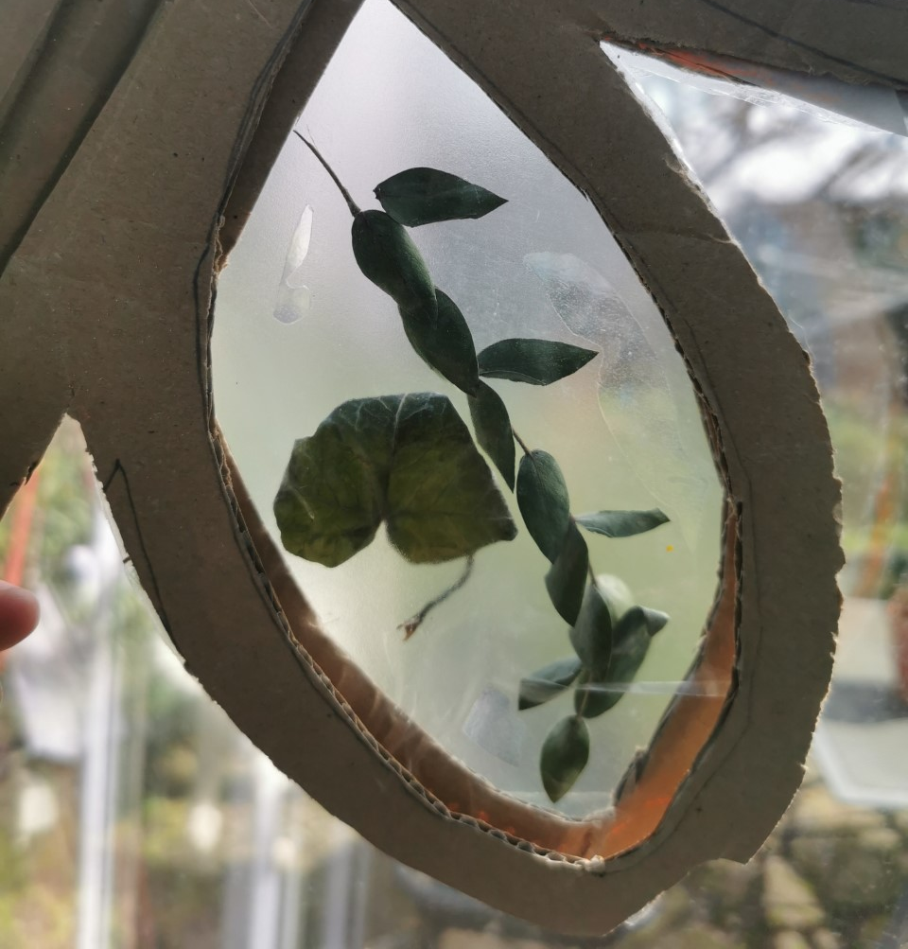
Now to fill the windows. You can do this with any translucent materials – and feel free to add colour.
This one has bubble wrap
This one has tissue paper
This one has sticky back plastic and leaves in-between
This one has the side of a plastic milk carton

Slide 6
You can have artistic license; you can use the same material for all the windows in the wings or mix it up.
You should add colour.
The carboard out line needs to be painted black on both sides, to keep them looking uniform to be exhibited in the Amelia Scott.
And remember to have fun!

