Slide 1
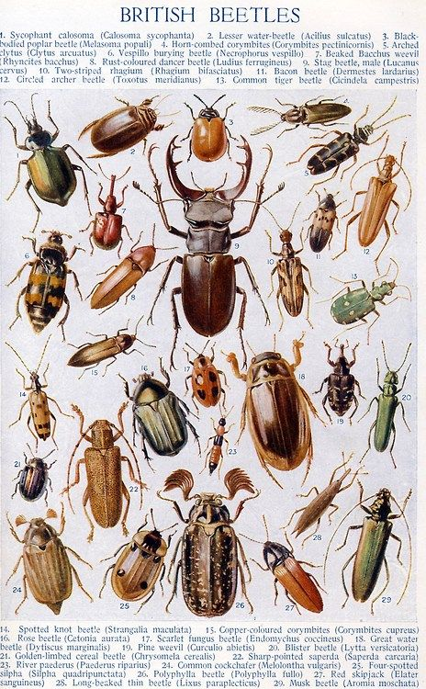
Beetles
Did you know there are over 4,000 types of beetles in the UK?

Slide 2
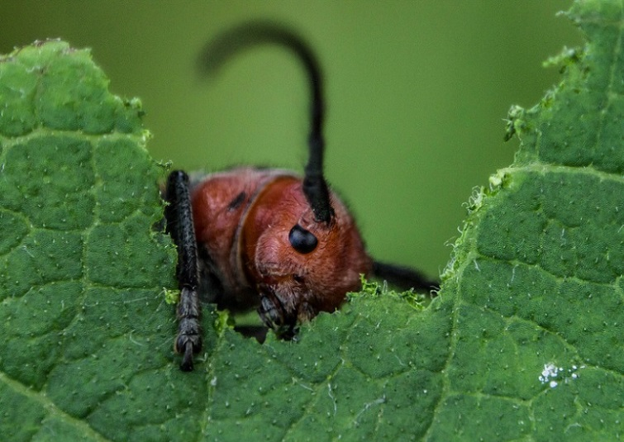
With over 4,000 beetles in the UK, we have plenty of choice and inspiration.
They come in a variety of shapes and sizes – but for this project we are going to be creating ours between 25cm squared (being the smallest) to 40cm squared being the biggest we can go.
As beetles help clean soil by eating waste products it would be great if we can use as many recycled materials as possible in our project.

Slide 3
Example
We will need:
Pen
Scissors
Sellotape
Cardboard
Carrier bags
Brown gummed tape /or newspaper and pva (paper-mache)
Paint
Tin foil (optional for the legs)
Wire/carboard/tin foil for the antenna – missing from picture
This is a great chance to work in a pair or as a small group.
Remember the underside has to be flat to mount onto the walls

Slide 4
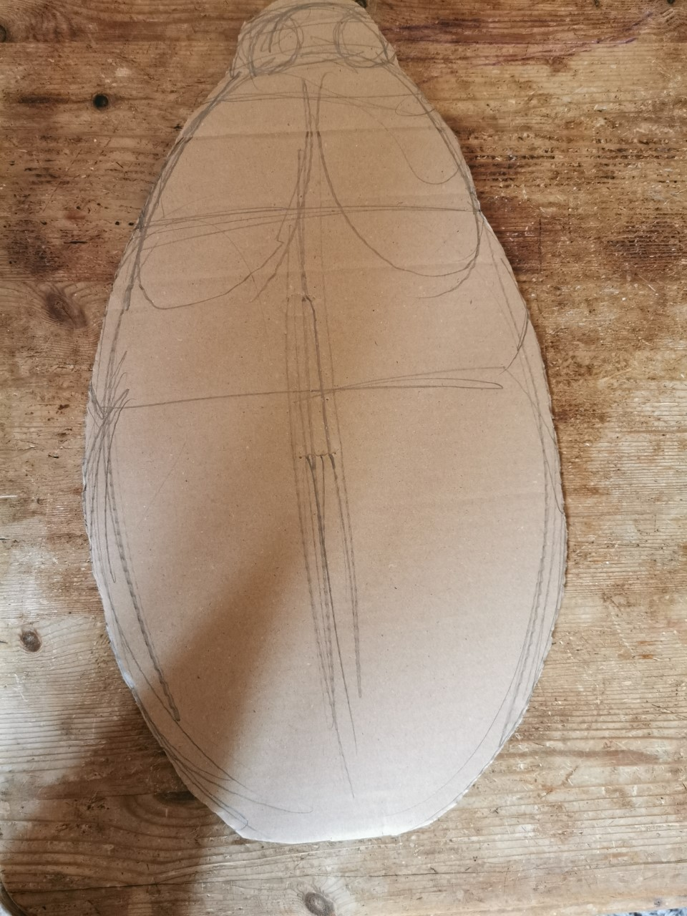
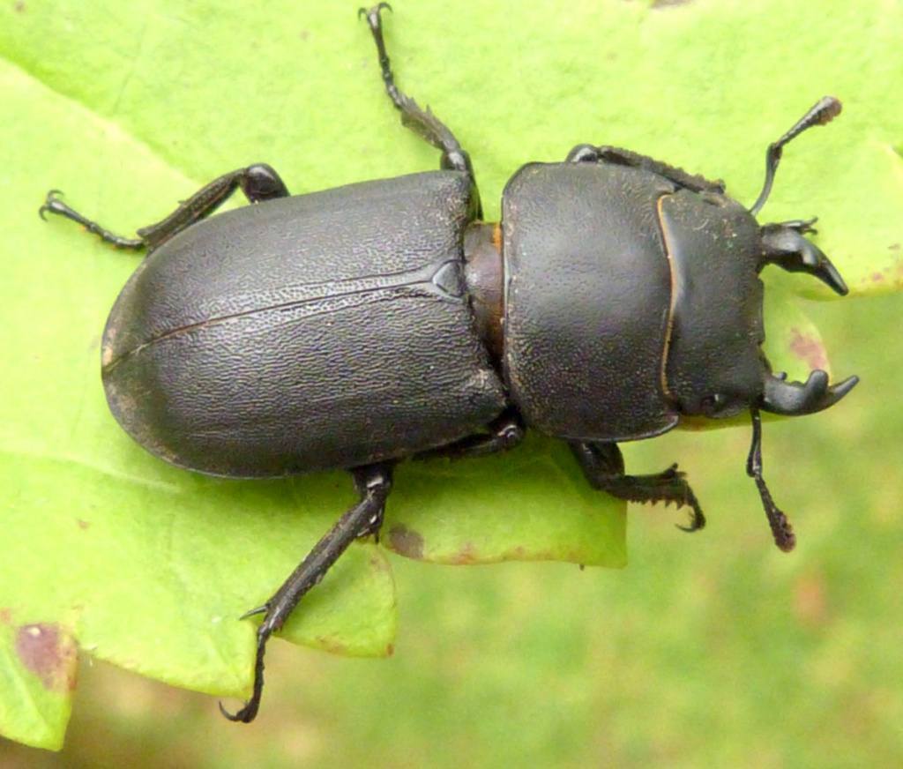
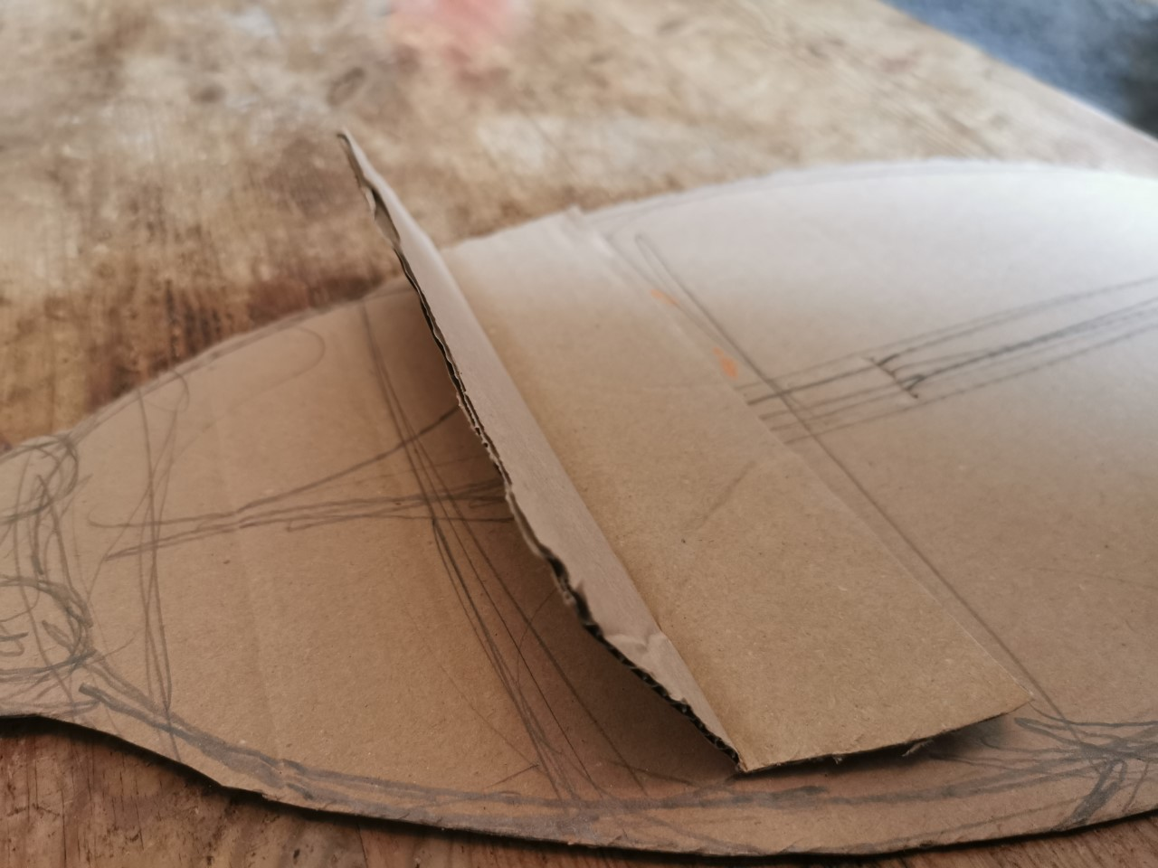
- Step one – decide and draw your beetle shape out onto cardboard – no bigger than 40cm squared
- Step two - cut it out
I have added I piece of cardboard for structure but to also help with the separation in the body that bugs always seem to have
This bit!

Slide 5
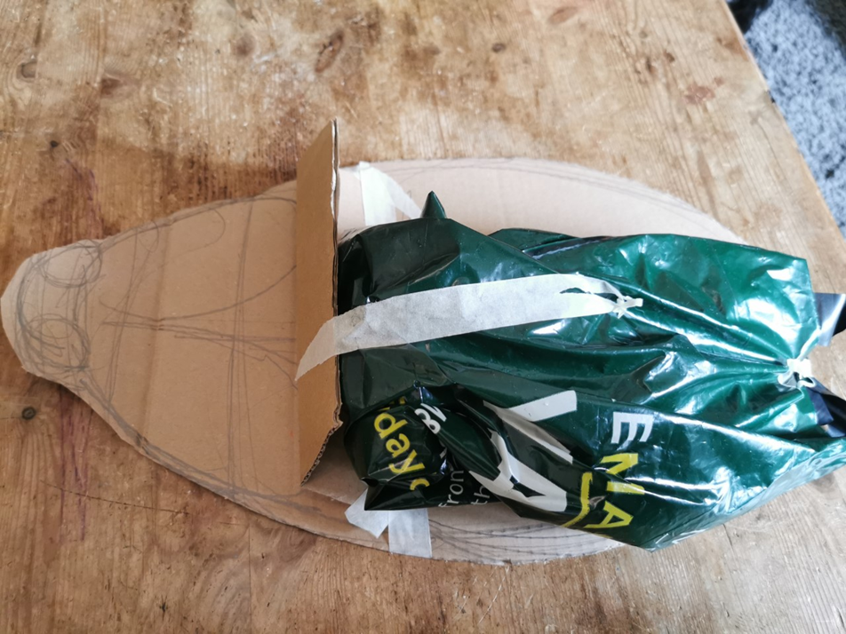
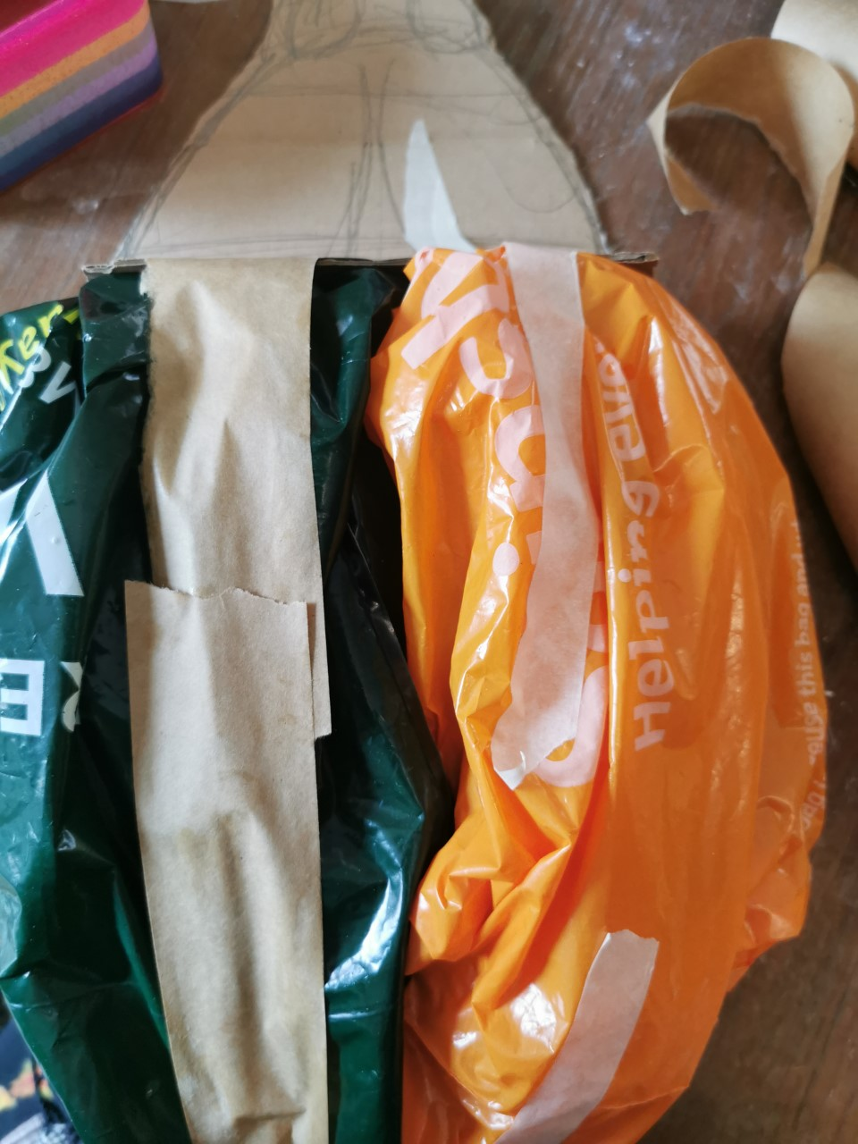
Creating volume/mass
I have used carrier bags to start creating the shape and the volume of the beetle. I have just sellotaped them into place.
I have used a carrier bag on each side of the shell where the wings are typically stored for protection – like a ladybird

Slide 6
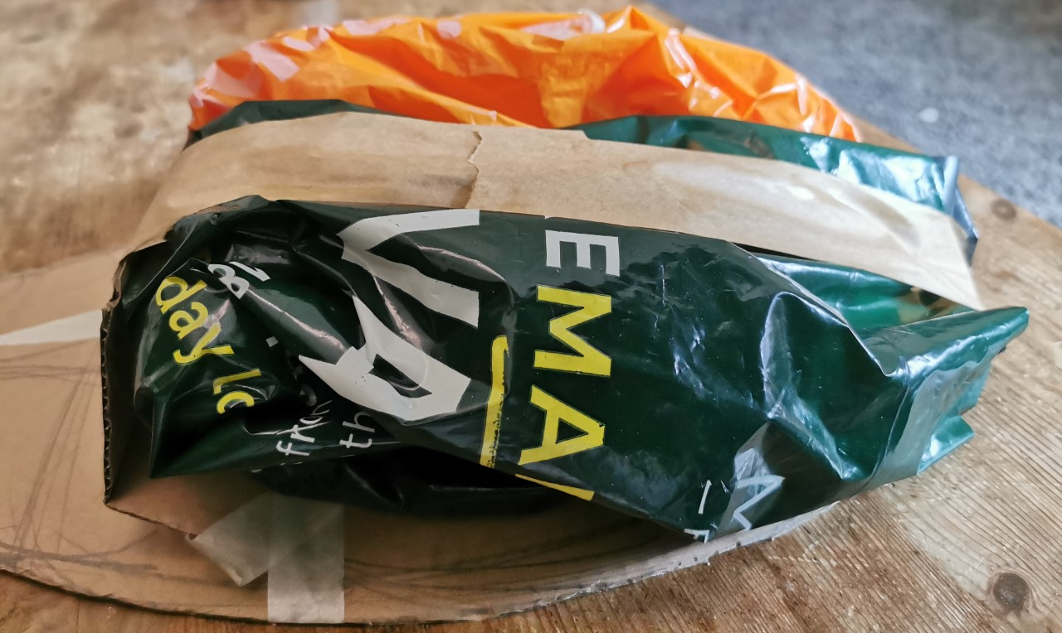
-
Once I was happy with the shapes of the wings shell, I used brown gummed tape – can use Paper Mache too.
Make sure you look around the whole shape of the beetle to make sure you're happy with your shape – but remember the back needs to be flat to mount onto the wall.

Slide 7
Once you are happy with the shape and texture , you need to get the paints out.
Remember that with the painting you can add the details of more texture and lines. Think about added depth and tone (shadows)

Slide 8
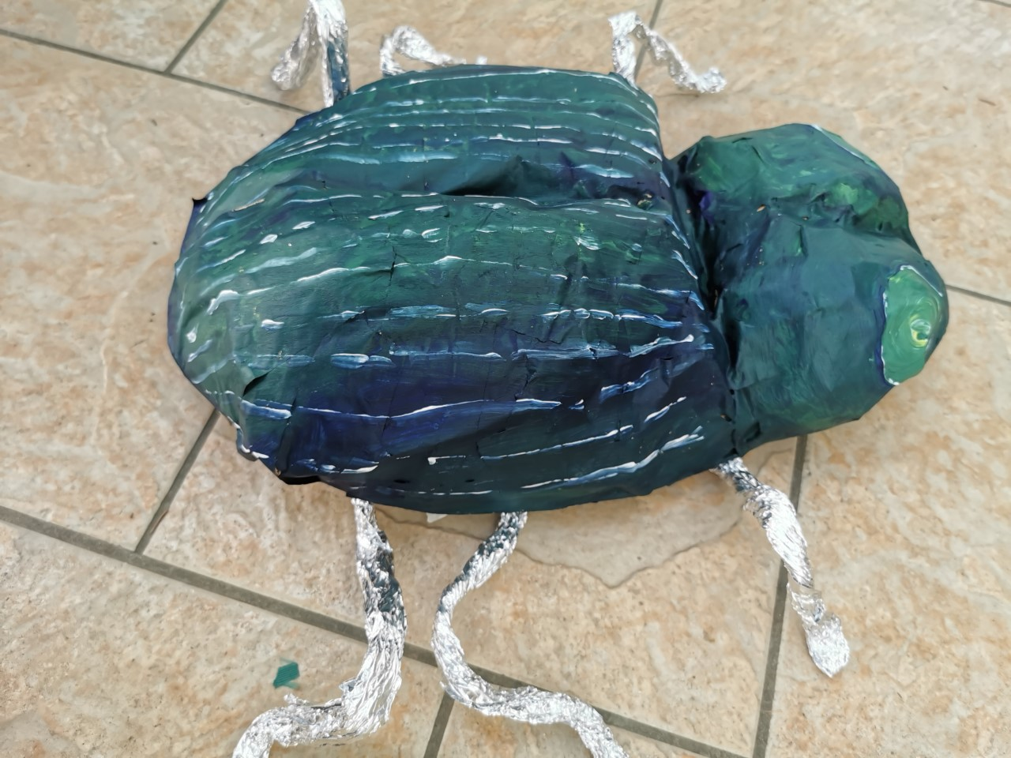
The legs are made out of tin foil twisted together
What's missing?
– his antennas!

