Slide 1
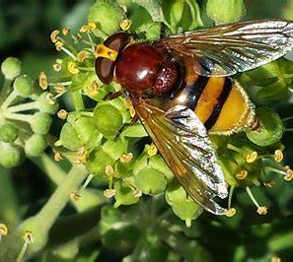
Pollinators
Bees, flies, dragon flies, wasps etc

Slide 2
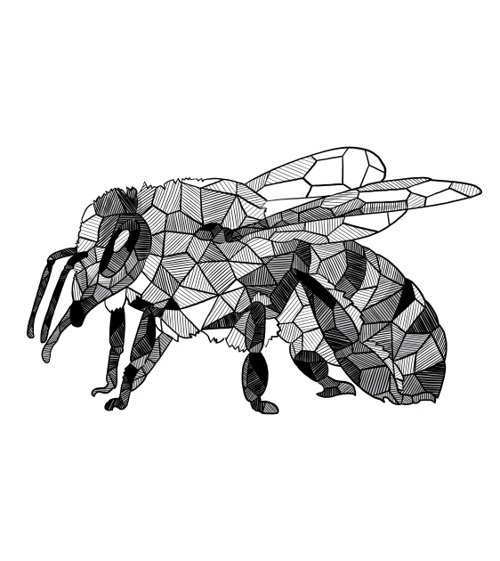
Geometric
Taking inspiration from geometric drawings, we are going to create a simpler 3d flying pollinator shape.
This is a guide; you can have artistic license to change the shape according to the pollinator you are creating.
The more recycled material you can use the better.

Slide 3
example
Wings are made out of plastic milk cartoons
Cardboard body – painted

Slide 4
Main body shape
The sides/stripes creates volume – gives structure to the shape.
I painted these black
I painted this yellow
This is the minimum, but more shapes can be added to the struture

Slide 5
This green hole is there to add the string to hang from
And the slot is there to add the wings
The red slots in the main body bring the body together, like an x shape
The blue slots allow the smaller shapes to be added to the main body. Be careful not to cut too far in
can be used for creating strips – 4 are needed to support the structure

Slide 6
The wings
For the wings we used a milk bottle and cut out the wing shape.
The yellow slot allows you to slot it through the hole of the body and stops the wings from falling out

Slide 7
Remember your work could be exhibited in the Amelia Scott Library.
Let’s make something we are all proud of and want to share with family and friends

